Slide 1
INTERNET PROGRAMMING AND MOBILE PROGRAMMING
GROUP 27
NYENTY PAUL EGBE
NKAFU VANIC ASONG
METIEGE OTILI-FAVOUR MECHANE
CHAM KANG NIBA
ASONGLEFAC ZINGWA LIONEL

Slide 2
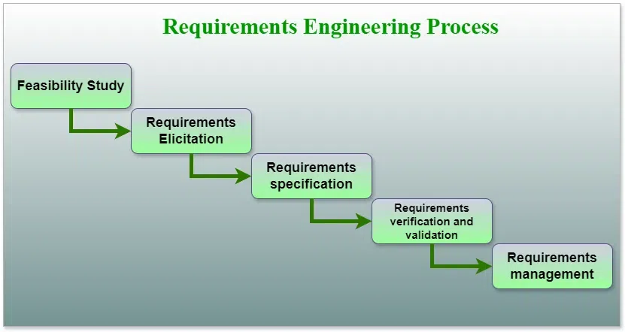
REQUIREMENT ENGINEERING
Requirements engineering is a systematic and rigorous approach to defining, creating, and verifying requirements for a software system. Collecting and analyzing user requirements for a mobile application is a crucial step in the development process to ensure that the final product meets the needs and expectations of its users. Here are some steps to effectively collect and analyze user requirements:

Slide 3
1. Feasibility study
Feasibility studies focus on five key areas: Technical, Operational, Economic, Legal, and Schedule. Among these, Economic Feasibility is crucial, while Legal Feasibility is less emphasized.
1. Technical Feasibility: Evaluates current resources, hardware, software, and required technology for project development. Determines if necessary resources and technologies are available and assesses technical team skills and capabilities.
2. Operational Feasibility: Analyzes the ability to meet requirements and ease of product operation and maintenance post-deployment. Considers usability, acceptance of suggested solutions, and other operational aspects.
3. Economic Feasibility: Examines project costs and benefits, including development, hardware, software, design, operational costs, etc. Determines if the project will be financially beneficial for the organization.

Slide 4
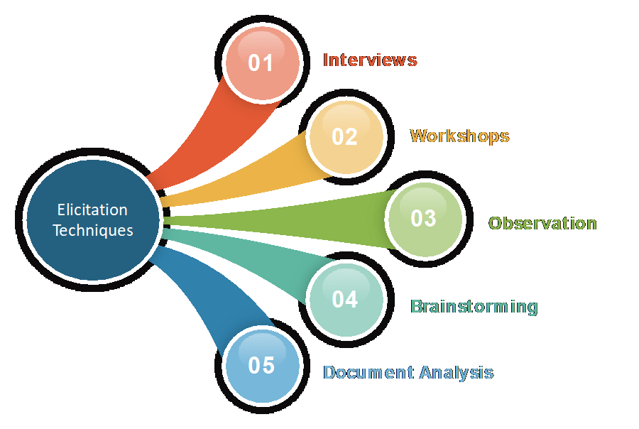
2.Requirement elicitation
Requirement elicitation is the process of gathering and defining what stakeholders need from a software system. It involves techniques like interviews and workshops to ensure clear communication and understanding. It's crucial for project success and involves ongoing refinement to accommodate changes and evolving needs.

Slide 5
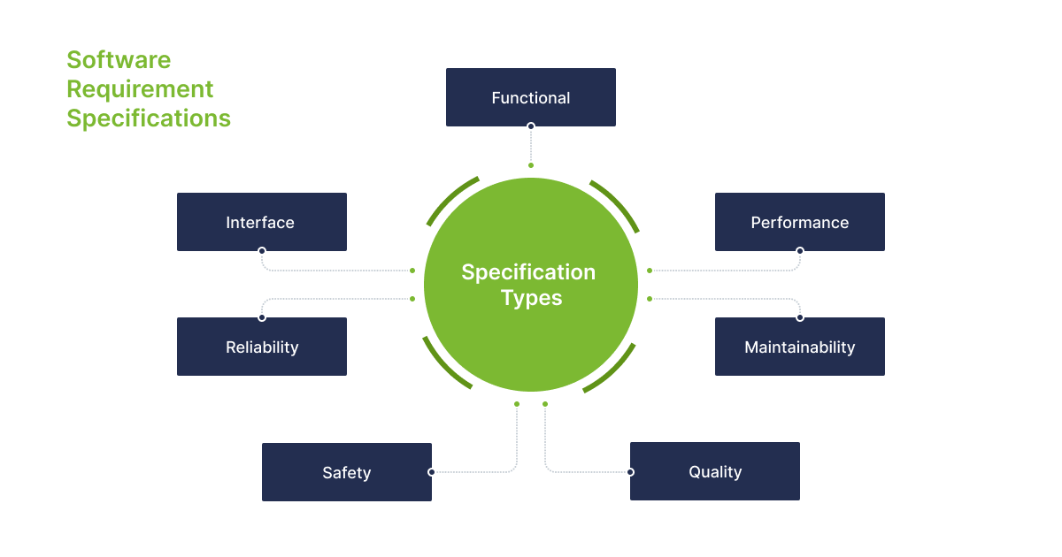
3.requirement specification
Requirement specification documents detail the functionalities, constraints, and quality attributes of a software system, guiding developers throughout the project. They ensure a shared understanding among stakeholders and prevent scope creep.

Slide 6
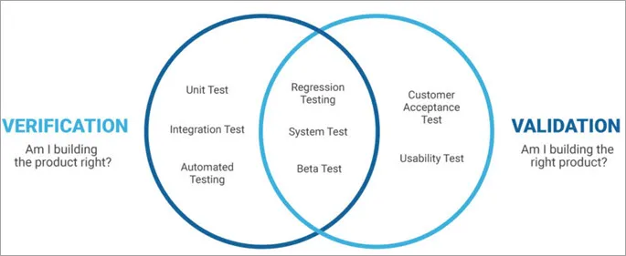
4. Requirements Verification and Validation
Requirements verification checks if documented requirements meet standards, while validation ensures the software meets stakeholders' needs. Both are vital for software quality.

Slide 7
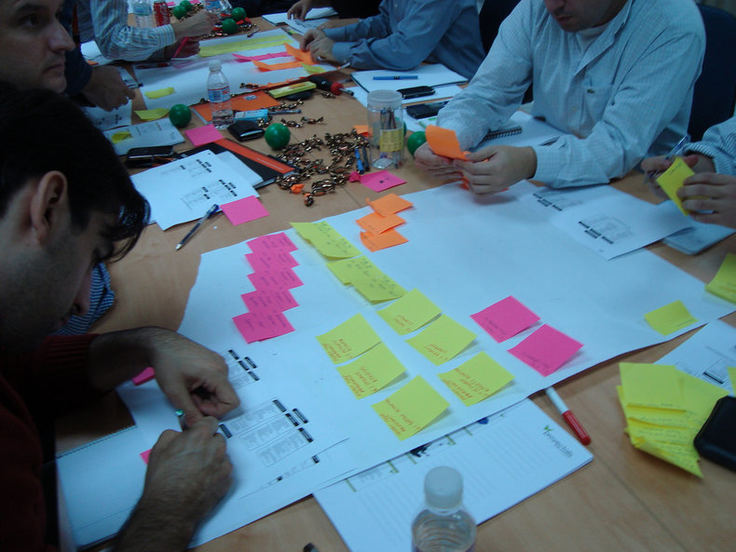
WHAT IS REQUIREMENT GATHERING
TYPES OF REQUIREMENT
BUSINESS REQUIREMENT
USER REQUIREMENT
SYSTEM REQUIREMENT

Slide 8

BUSINESS REQUIREMENT
BACKGROUND
Road safety is a challenge in Cameroon due to reckless driving, poor car maintenance, and lack of timely information to drivers.
BUSINESS OPPORTUNITY
Unlike many existing apps, ours encourages user contributions on hazards and road safety, likely leading to a surge in downloads and filling a gap in existing platforms
BUSINESS OBJECTIVES
We aim for 100,000 downloads at launch, targeting $2000 monthly revenue and a 20% ROI within the first year

Slide 9

SUCCESS METRICS
We anticipate 100,000 road users downloading the app at launch. By the end of the first year, our goal is to generate at least 1,300,000 xaf per month in revenue.
VISION STATEMENT.
“DriveSafe” is a mobile app designed for all road users, focusing on safety and providing real-time updates on road signs and conditions
MONETIZATION MODEL.
While the mobile app will be free to use, we plan to generate revenue through in-app adverts.
BUSINESS RISKS
To increase downloads, we’ll engage local media and launch a comprehensive social media campaign for widespread publicity

Slide 10
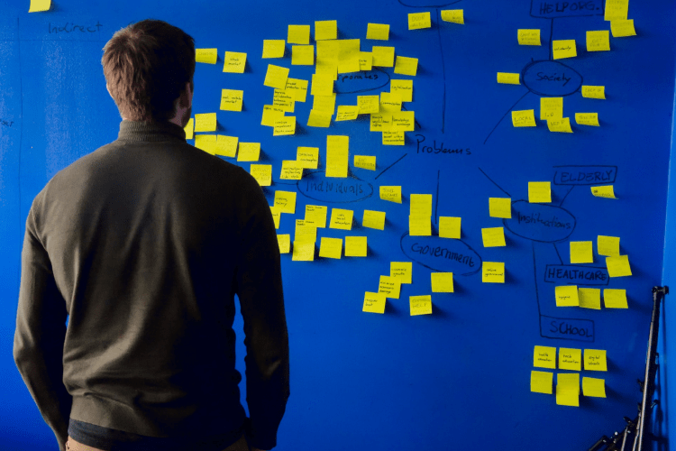
USER REQUIREMENTS
FUNCTIONAL USER REQUIREMENTS
Create accounts, send information on road hazards, custom app.
Non-FUNCTIONAL USER REQUIREMENTS
App interface should be intuitive, learnable and user friendly, compatible with mobile devices
DEPLOYMENT CONSIDERATIONS
App will be initially launched in Cameroon and subsequently be upgraded to be used in other countries

Slide 11

SYSTEM REQUIREMENTS
FUNCTIONAL REQUIREMENTS
DriveSafe lets users log in and contribute data, while also customizing notifications based on location and time preferences
BUSINESS RULES
The app must comply with government road safety regulations and international privacy standards such as ISO/IEC 27701 and ISO/IEC 29100:2011
DATA REQUIREMENTS
DriveSafe efficiently manages data with clear requirements, defined entities, enforced analysis, and diverse report generation

Slide 12

QUALITY ATTRIBUTES
DriveSafe should be user-friendly, high-performing, and secure for end-users, while also supporting efficient test case
EXTERNAL INTERFACES
Fonts should be clear and readable, icons standardized for consistency, high contrast for readability, high quality images, and layout should have a responsive design. Clear interactions between APIs and databases, platform support for Android and ios
CONSTRAINTS
Enabling Google Maps requires a credit card, posing a challenge, integrating Orange MOMO involves payment for the Dart-based API prompting developers to learn a new language.
LOCALIZATION REQUIIREMENTS
The app will be adapted for international use by addressing: currency, date, number, address and telephone formats, language, time zones, and other variables.

Slide 13
THANK YOU

